Slide 1
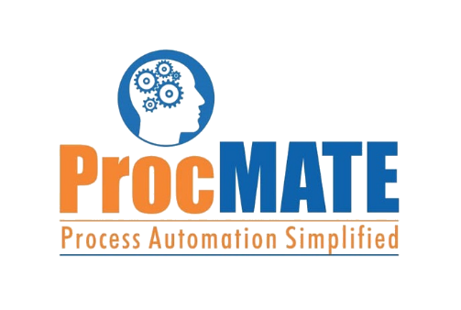
Before Implementing AP Automation
Existing PO Process
Email PO to Supplier
Wait for supplier to deliver goods
Receive Delivery
Perform Goods Receipt
Process Classification
Supplier Invoice & Delivery Order (DO) received by warehouse
Courier Supplier Invoice & Delivery Order to Head Office
Wait for courier to arrive
Invoice
Received?
More than “n” number of days
Request for Invoice and Delivery Order again
Manual
No
Yes
Wait
No
Yes
Wait
Semi-automated
Manual Invoice Checking
Manual Checking of Delivery Order (DO)
Goods Received
Everything ok?
Data Entry to Accounting System and in ERP
Automated
Yes
Yes
No
No
3 way matching in ERP - Purchase orders, supplier invoices & goods receipts
Inform Supplier
Payment Process

