Slide 1



Microsoft Training Service Partner (TSP)
Innovate | Integrate | Automate – Global Presence with Local Reach

Slide 2


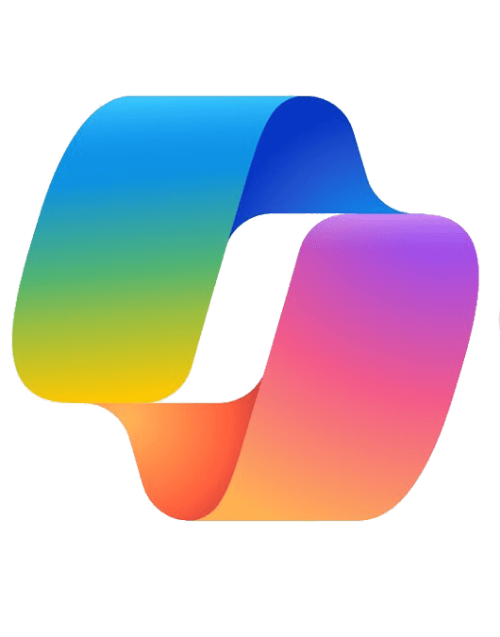
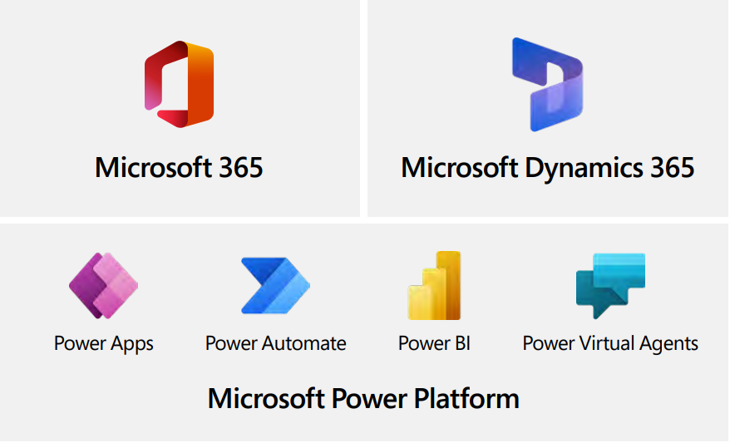
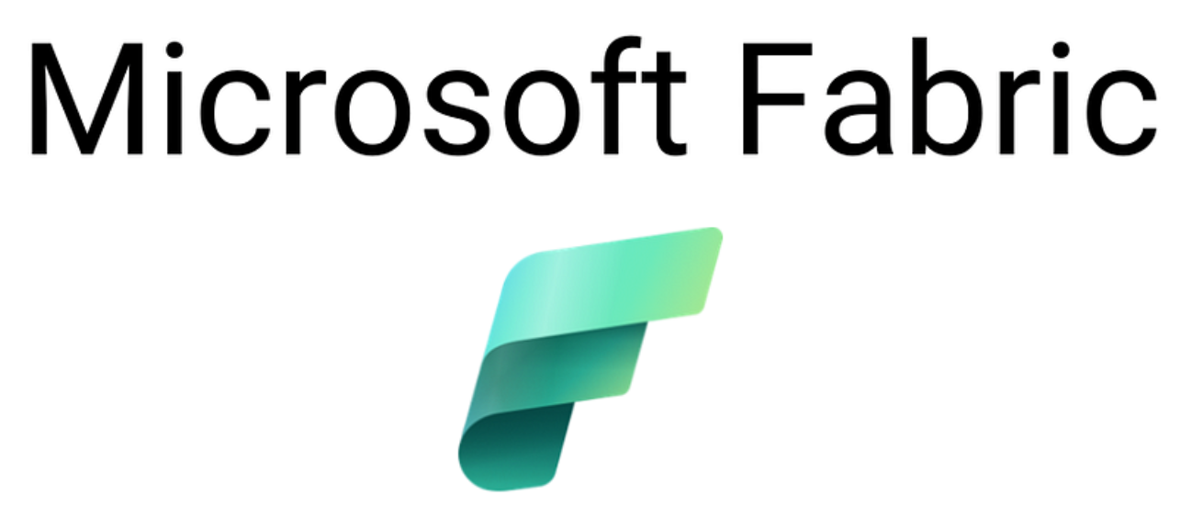

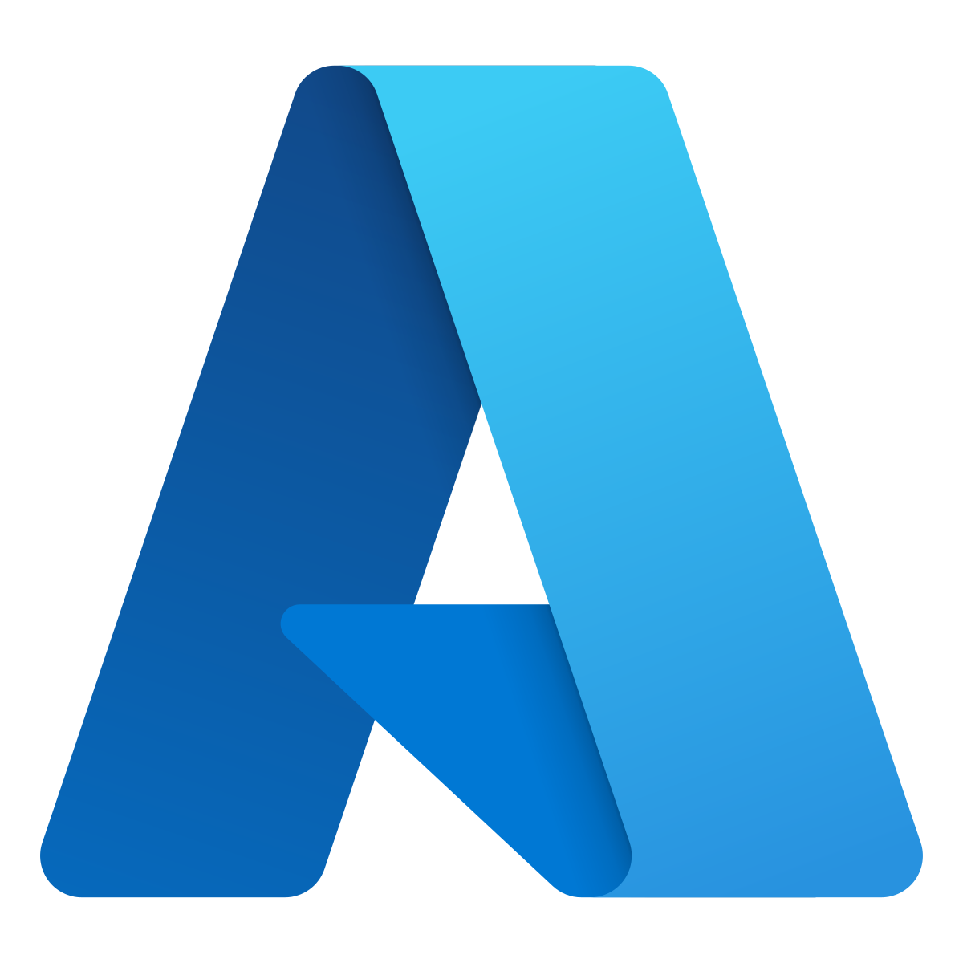
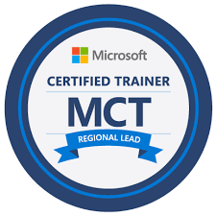
Microsoft Solutions & Services
Consultation
Implementation
Integration
Maintenance and Support
Licensing
Migration and Upgradation
Workshops on Microsoft Copilot
& AI Agent, Microsoft Fabric
Co-Pilot with AI Technology
Modern Workplace
Enterprise Application
Data & AI
Low code Technology Solutions
Azure
Copilot Studio
Infrastructure
& Platform Services
Microsoft TSP
[Training Service Partner]
Training Services
SMB – Mid-Market – Large Enterprise
&
All Business Verticals
Workshop / Corporate Training across Microsoft Solutions
2

Slide 3



The AI advantage for sales
Leading companies estimate that sales organizations can benefit significantly from generative AI
Sales efficiency
Data quality + sales effectiveness
29%
+50%
jump in lead-to-sale
conversion rate⁴
of sales time can be automated¹
3-5%
3-15%
of revenue uplift for players
that invest in AI⁴
productivity lift²
(total sales expense)
99%
of sellers would reinvest time saved from AI on work tasks³
2X
lift in cross-selling and up-selling rate⁴
¹Bain & Company. "How Generative AI Will Supercharge Productivity.” August 2023.
²McKinsey. “The economic potential of generative AI: The next productivity frontier.” June 2023.
³Microsoft. “Sellers’ attitudes about AI.” June 2023. An Ipsos study commissioned by Microsoft. Study included 700 participants who use professional CRM systems at organizations of at least 300 people. Industries include Financial Services, Professional Services, Manufacturing, Retail, Technology, and Healthcare.
⁴McKinsey. “AI-powered marketing and sales reach new heights with generative AI.” May 2023.

Slide 4

Agents are radically improving seller efficiency, effectiveness
Yesterday
Today with AI
Marketing Engaged Lead (MEL)
Sales Handoff
Marketing Qualified Lead (MQL)
Marketing + Agents
Sales Qualified
Lead (SQL)
Sales Handoff
2.3x
Sales and marketing teams with stronger collaboration more likely to attain strong commercial growth
Sales engages with fewer,
more qualified leads
Sales
Opportunity
Close-Won Customer
How to Follow Up With Sales-Qualified Leads: 3 Best Practices to Seal the Deal – Gartner, April, 2025

Slide 5
Scale your sales team with AI agents
Sales Chat
Enables sales teams to ask questions and query data across web, Office Graph, and CRM datasets using natural language.
Sales Close Agent
Works autonomously to monitor, research, and prioritize inbound leads and can develop personalized outreach emails based on research and insights. Can pass on leads as well as autonomously close deals.
Sales Research
Agent
Provides deep insights
and actionable recommendations to sales teams by analyzing cross-domain enterprise data from multiple sources.
Sales Qualification Agent
Works autonomously to monitor, research, and prioritize inbound leads and can develop personalized outreach emails based on research and insights.
Microsoft 365 Copilot Chat
and/or Copilot Chat
Dynamics 365 Sales
Dynamics 365 Sales
Dynamics 365 Sales
Product videos hyperlinked in agent names above
Eliminate guesswork, accelerate deals, and optimize every customer interaction with AI-driven sales intelligence.

Slide 6
Agents in Dynamics 365 Sales cover the full sales cycle
Roles
Sales Development Representative
Sales Representative
Sales Leader
Supervision
Goal
Generate Pipeline
Win Deals
Grow Revenue
Optimize Business
JTBD*
Research Leads
Customer Outreach
Qualify Leads
Convert
Hand Off
Discover Use Cases
Present Value
Prove Value
Negotiate
& Close
Manage Pipeline
Team, Account, & Territory Planning
Assess Sales Ops
Agents
Sales Qualification Agent
Sales Close Agent
Sales Research Agent
User invoked or fully autonomous working on behalf of a group
User invoked, delivering the work of a team
Sales capabilities in M365 Copilot
* Jobs to be done

Slide 7

A day in the life of your Inside Sales Team
Ethan uses Sales Agent that autonomously operates 24/7
Pipeline
management
Personalized
outreach
Enriched customer profiles
Ethan ensures no lead is left behind by using the autonomous Sales Agent to scale outreach and transform leads into opportunities.
Ethan oversees the creation of personalized outreach. The Sales Agent proactively drafts these communications, ensuring they are always tailored and effective.
Ethan leverages Sales Agent to research leads, find helpful information, and determine if they are a good match for the products or services being sold.
Find more leads in my territory based on the qualification targets outlined in this document.
Send unique, customized emails for each of my prioritized leads based on research.
Research new leads from last week’s event and show me the company, contact, and their business objectives.

Slide 8
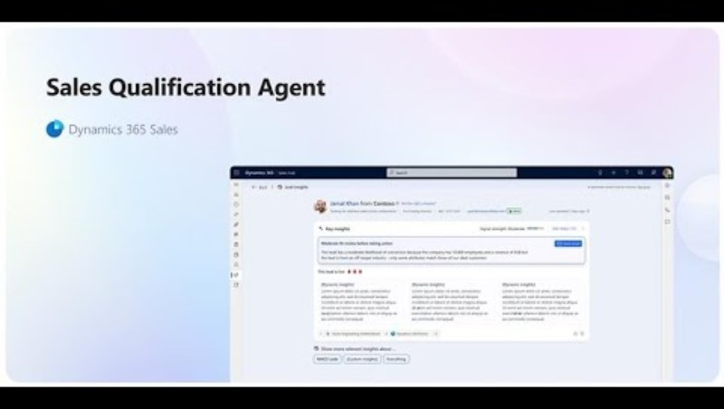
Sales Qualification Agent (Demo):
https://youtu.be/g-zpeJ_W65w

Slide 9
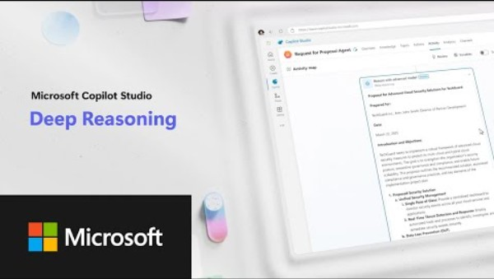
Sales RFP Agent built on Copilot Studio:
https://youtu.be/_v9ri9eoVFg

Slide 10
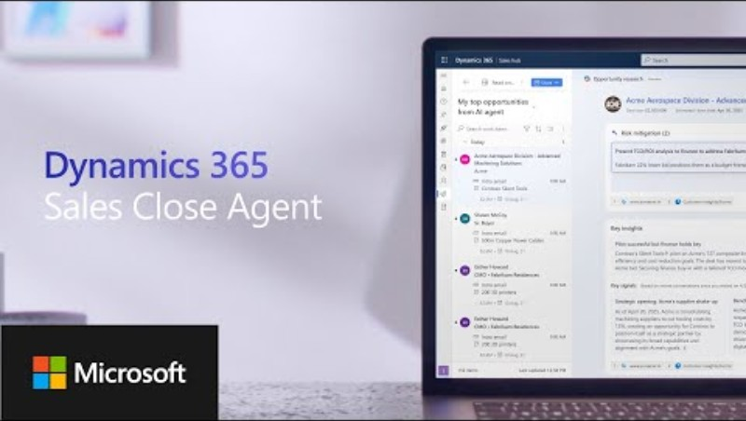
Sales Close Agent :
https://youtu.be/m8MCEZ8OBqk

Slide 11

A day in the life of your sales leader
Grace, a sales leader, is responsible for maximizing revenue and ensuring her team closes deals
Actionable recommendations
Pipeline health assessment
Confidence in
decision-making
Grace uses Sales Research
Agent to deliver actionable recommendations and turn raw data into clear, data-backed decisions.
Grace reviews insights into the health of her sales pipeline, deal prioritization, and territory planning to maximize revenue.
Grace drives growth with confidence by leveraging AI-powered tools that provide comprehensive analysis and recommended next steps.
Analyze cross-domain data
from my CRM and ERP to give
me recommendations on closing deals this quarter.
Prioritize deals for my sales team to focus and create action plan for my sellers to execute based
on their territory mapping.
Identify potential risks and recommend strategic next steps to maximize revenue and optimize sales execution.

Slide 12
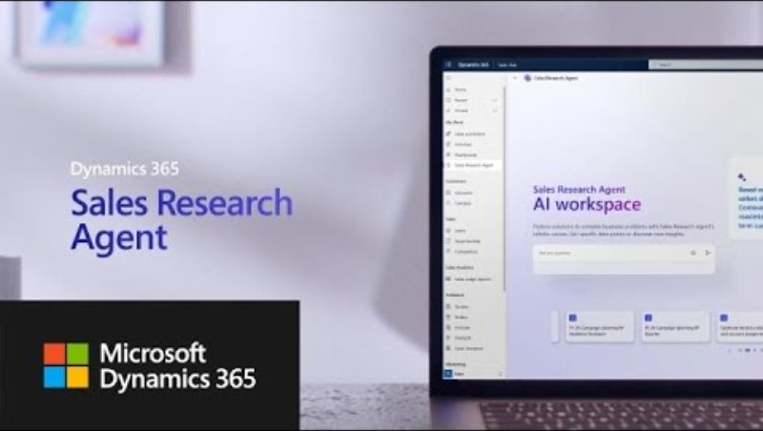
Sales Research Agent:
https://youtu.be/S8PkHL2nO44

Slide 13



Why Microsoft for agentic transformation
Microsoft brings it all together—platform, productivity, and AI—to power the next era of CX
One cloud, one platform, one vendor
Open, flexible integration
Market and
AI leader
Deliver end-to-end service experiences on a single Microsoft cloud—connecting channels, roles, and datasets through one trusted platform.
Bring AI and automation to the tools you already use—integrating with Microsoft 365, third-party systems, and your existing investments.
Rely on a proven leader in service and AI—with the scale, security, and innovation to support your complete service journey.
>20%
of customers migrate to Dynamics 365 in less than 8 months
Based on Microsoft internal data

Slide 14
Why Microsoft for agentic transformation
Microsoft brings it all together—platform, productivity, and AI—to power the next era of CX
One cloud, one platform, one vendor
Open, flexible integration
Market and
AI leader
Deliver end-to-end service experiences on a single Microsoft cloud—connecting channels, roles, and datasets through one trusted platform.
Bring AI and automation to the tools you already use—integrating with Microsoft 365, third-party systems, and your existing investments.
Rely on a proven leader in service and AI—with the scale, security, and innovation to support your complete service journey.
>20%
of customers migrate to Dynamics 365 in less than 8 months
Based on Microsoft internal data

Slide 15


Connect With Us.
www.compusoftadvisors.com
Email : amit.kumar@compusoftadvisors.com
Social Media
Call us
www.compusoftadvisors.com
(+91)-9819813368

